Slide 1
OneQuesh
Team B3
Hanyu, Luke, Ting-Ann(Ann), Yuyan(Mona), Yipeng(Caroline)

Slide 2
Agenda
01
02
03
04
Introduction
Text Analysis
Clusters
Next Steps
Background
Hypo
Data
Sentiment
Character count
K-Means
H-Cluster
Users’ Data Insights

Slide 3
01
Introduction

Slide 4

Background & Our Target
OneQuesh is a start-up company that create a social media app.
We would like to explore and analyze what kind of questions gain higher popularity ratings;
Build model to pick those ‘will-be-popular’ questions
…
Post! 😊
Notes:
merge with the following

Slide 5
What Are Our Hypothesis?
Hypo 1:
Popular (interesting) Quesh may have more responses, more characters (initiate people to talk more), and more positive responses (higher sentiment score), so-called good questions
Hypo 2:
We suppose these good questions can generate more attention for OneQuesh, and make it a more successful company.
Hypo 3:
We assume we can find out the common sense among good questions, and train a model to pick for further use,
Notes:
update

Slide 6
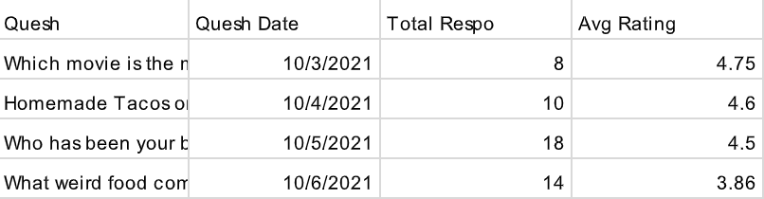
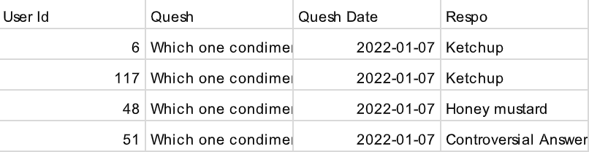
What Data Do We Have For Now?
Question Data
Response Data

Slide 7
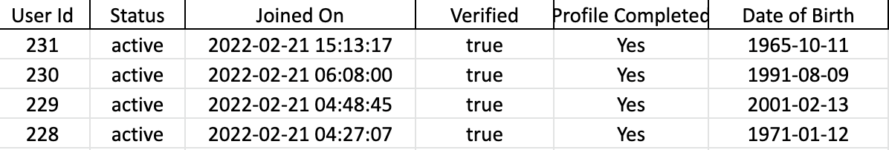
What Data Do We Have For Now?
Users’ Data
With these sophisticated dataset, we would be able to dig deeper into this topic.
Notes:
add the comments

Slide 8
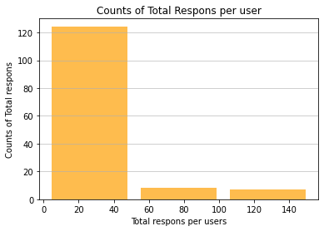
Response data EDA
2395
Total Number of Response
73
The Number of comments for the question
63.8%
User Responding rate Rate(139/218)

Slide 9
02
Text Analysis

Slide 10
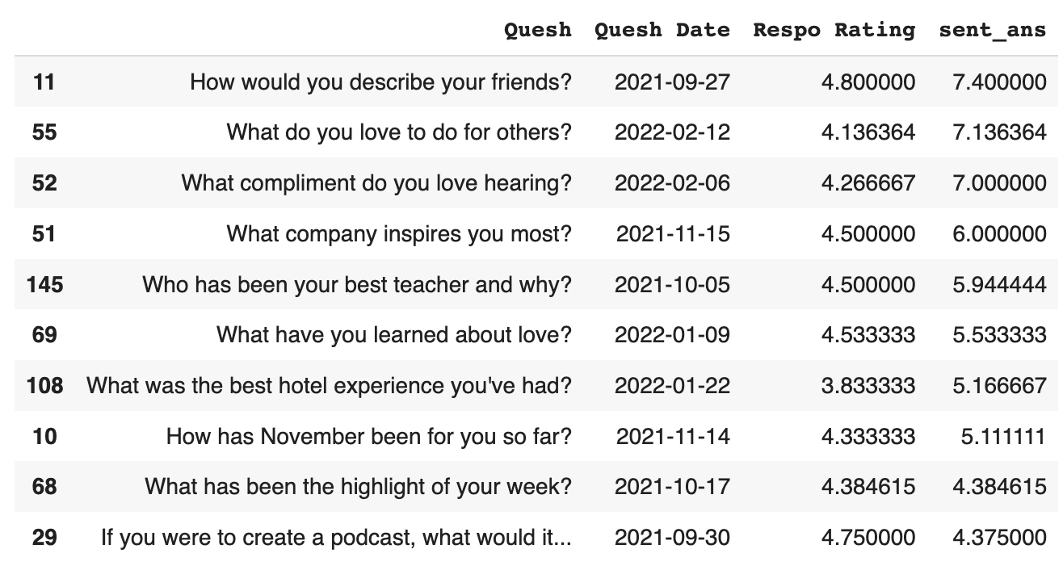
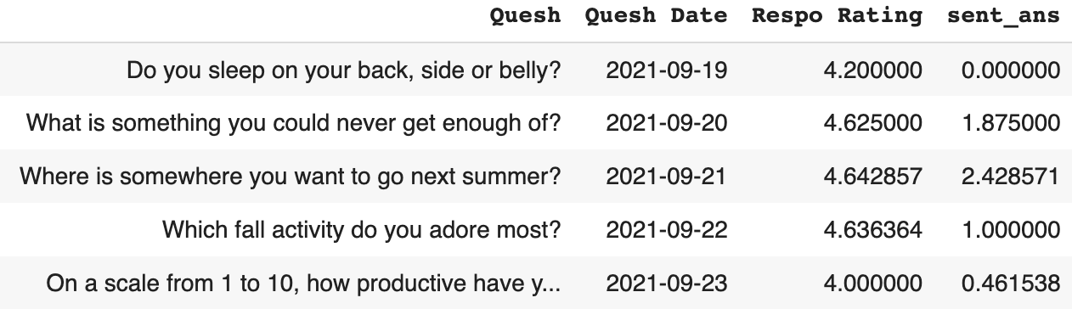
2.1 Sentiment Analysis
The average sentiment score of the responses by each question
And we have the ranking…
Notes:
Ann

Slide 11
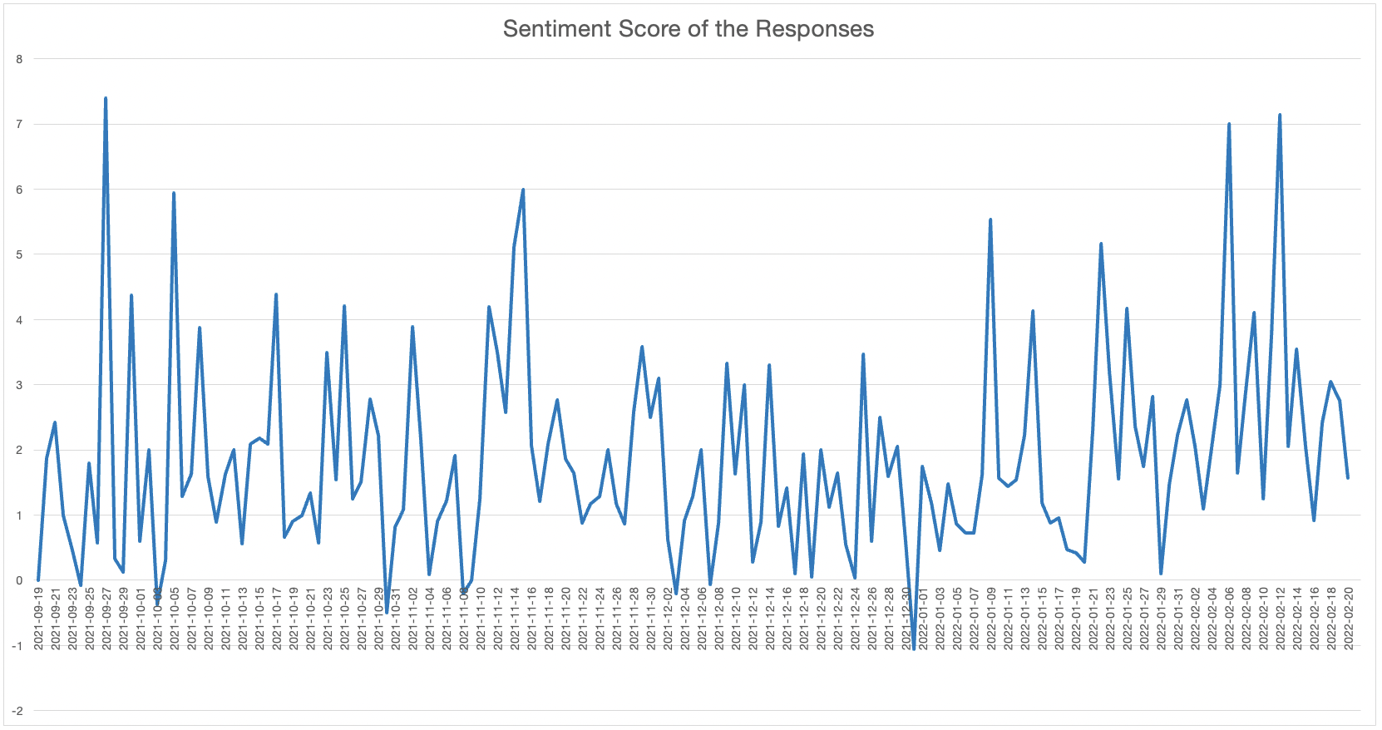
2.1 Sentiment Analysis
The distribution of sentiment score by date
There are dramatic changes
Notes:
Ann

Slide 12
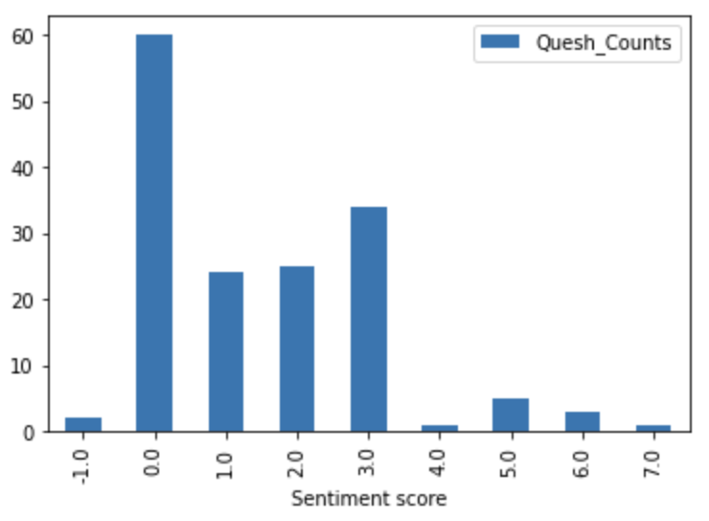
2.1 Sentiment Analysis
We also have sentiment score for the questions
The majority is from 0 to 3
Notes:
Ann

Slide 13
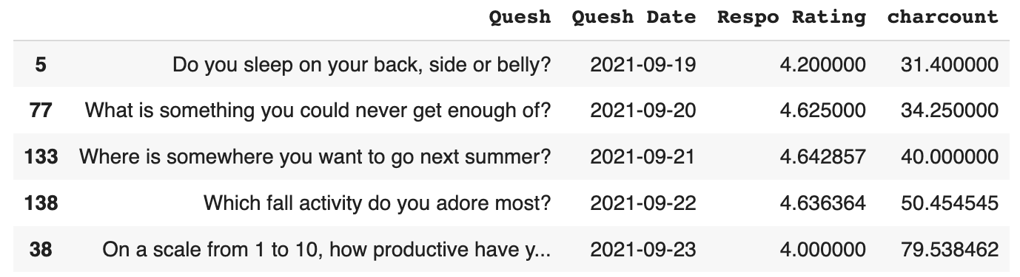
2.2 Character Counts
Every response have its character count
Group by Quesh and get the average character count for each response

Slide 14
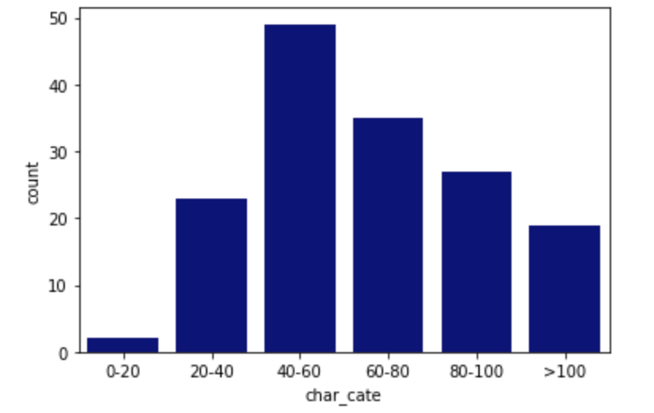
2.2 Character Counts
Most of the response character counts are around 40-60
Subscribers who answered questions tends to answer in a full sentence instead of response in couple of words.

Slide 15
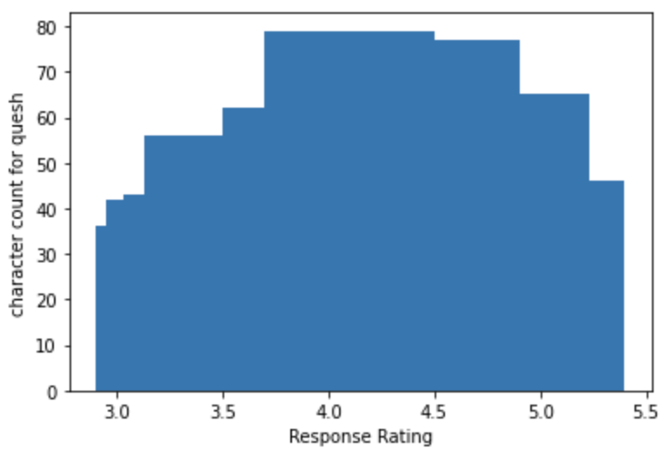
2.2 Character Counts
Character Count for Each Response Rating
Most of the questions has around 70-80 character counts and has a response rating of 4.0 to 4.5
The highest response rating has character counts around 45

Slide 16
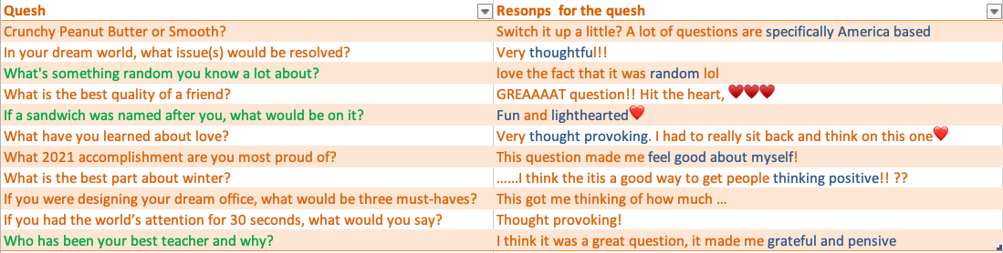
2.3 Analysis towards Comments
Based on analysing comments for the questions
Green questions - Very good question (Highly commented question)
Blue keyword - insightful keywords

Slide 17
About the QUESTIONS
1. More diverse not just american based
2. Thoughtful
3. Random
4. Fun and lighthearted
6. Thought provoking and pensive
7. Feel good about self
8. Thinking positive
Notes:
some other points

Slide 18
03
Clusters

Slide 19
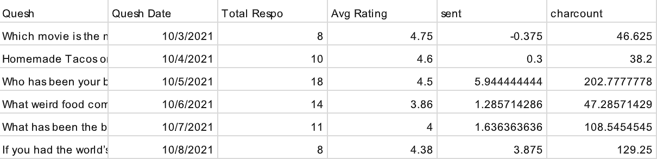
After That… We Have the Featured Dataset

Slide 20
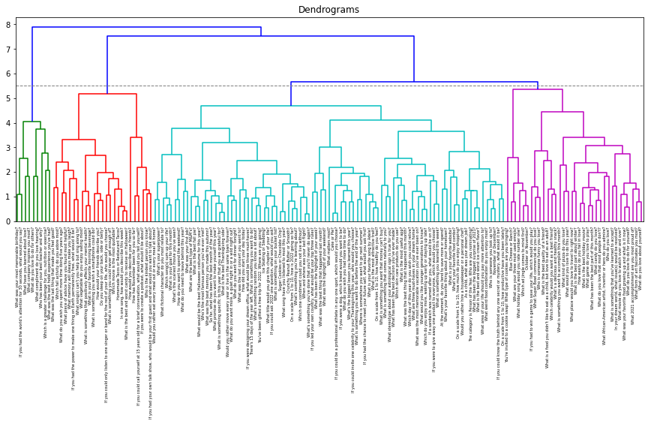
Hierarchical-Clustering
Group of cases (observations/rows) based on similarities in input values
Use the input as a categorical value for Supervised Machine Learning
Profile the segments to tell a story and take action
Notes:
Use the input as a categorical value for SML
Profile the segments to tell a story and take action
Hierarchical Clustering (Hclust)
Also referred to as agglomerative clustering
A "bottom-up" approach
Intuitive approach and let's us as analysts determine our cluster solution

Slide 21
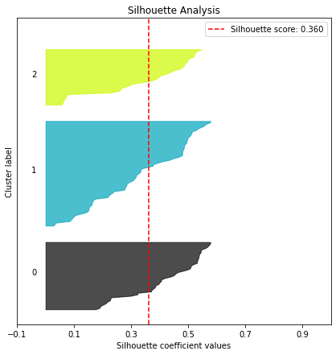
K-means Clustering
k = 3 clusters
Unsupervised machine learning method
Takes in numerical features
Partitions n observations into k clusters in which each observation belongs to the cluster with the nearest mean calculated by squared Euclidean distance
Notes:
Cluster Analysis - Bigger Picture
Group of cases (observations/rows) based on similarities in input values
Unlike supervised learning, no label exists, so cluster labels are generated
Sometimes we elect to remove variables that could act as targets in SML tasks.
We do this avoid remove impact on cluster determination and to profile later.
When we have clusters, we can:
Use the input as a categorical value for SML
Profile the segments to tell a story and take action
K-Means Clustering
We set the number of clusters up-front, this is K
The algorithm uses K to identify clusters from our search space
This is usually done by minimizing the distance from each point to it's cluster center
This is the topic for next week

Slide 22
04
Next Steps

Slide 23
By 2.21.22
Total users : 218
Users Data EDA
98.1%
Active Rate
83%
Verified Rate
96%
Profile completed Rate

Slide 24
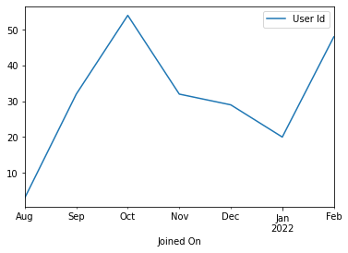
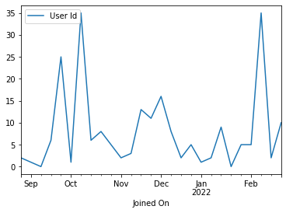
New User Joining Time Trade
Monthly
Weekly

Slide 25
Top 20 User
User Id | Status | Joined On | Verified | Profile Complete | Data of BirthDay
4 | active | 2021-09-19 10:15:22 | True | Yes | 1992-05-02
11 | active | 2021-09-20 04:54:19 | True | Yes | 1974-03-16
5 | active | 2021-09-19 17:14:06 | True | Yes | 1970-07-11
15 | active | 2021-09-21 14:45:05 | True | Yes | 1995-02-23
51 | active | 2021-10-05 13:52:25 | True | Yes | 1990-03-14
14 | active | 2021-09-20 21:53:40 | True | Yes | 1994-10-05
6 | active | 2021-09-19 17:22:33 | True | Yes | 2000-03-20
67 | active | 2021-10-06 11:47:03 | True | Yes | 1993-07-11
75 | active | 2021-10-07 19:02:41 | True | Yes | 1975-03-22
130 | active | 2021-12-01 14:00:27 | True | Yes | 1961-04-28
77 | active | 2021-10-11 15:33:40 | True | Yes | 1980-09-11
48 | active | 2021-10-05 12:49:11 | True | Yes | 1985-09-18
156 | active | 2021-12-20 12:23:09 | True | Yes | 1991-10-18
22 | active | 2021-09-22 03:18:57 | True | Yes | 1993-07-07
118 | active | 2021-11-23 00:14:26 | True | Yes | 1990-03-06
9 | active | 2021-09-19 18:03:05 | True | Yes | 1962-01-11
157 | active | 2021-12-20 14:59:57 | True | Yes | 1993-06-29
134 | active | 2021-12-01 18:45:29 | True | Yes | 1978-03-10
114 | active | 2021-11-19 14:54:02 | True | Yes | 1979-09-21
81 | active | 2021-10-16 04:10:27 | True | Yes | 1964-06-05
(on basis of total number of response)

Slide 26
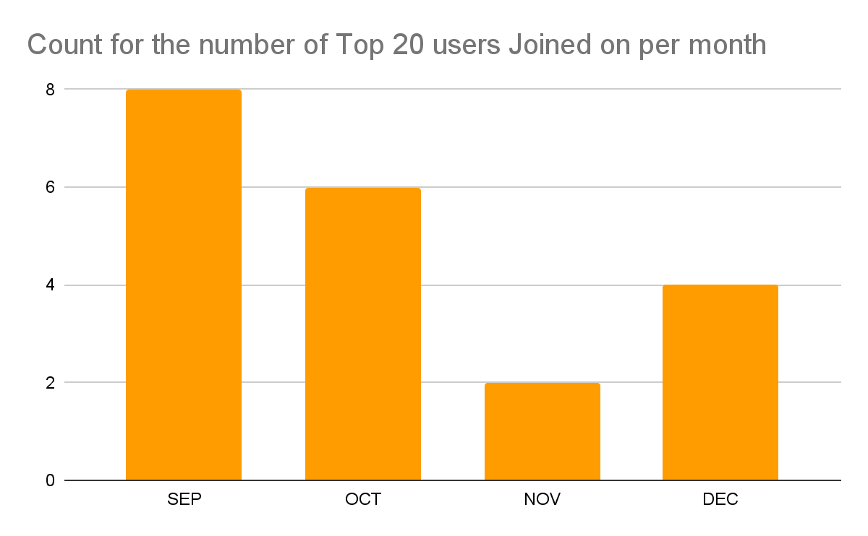
Top User Joined data Distribution
The results from users’ aspect are not conclusive for now.

Slide 27
Thanks!
Any Quesh?

